Slide 1
Ancient Greek for Everyone: A New Digital Resource for Beginning Greek Unit 1 part 2: consonants
2015 edition
Wilfred E. Major
wmajor@lsu.edu

Slide 2
Ancient Greek for Everyone
This class
Finish learning the Greek letters!

Slide 3
Ancient Greek for Everyone
Yesterday we learned the Greek vowels.
For review:
α “ah”
ε “eh”
ι “ih”
ο “o”
υ “u”

Slide 4
Ancient Greek for Everyone
Short
Long
α “ah”
ε “eh”
ι “ih”
ο “o”
υ “u”
ᾱ “aah”
η “ay”
ῑ “ee”
ω “oh”
ῡ “οοh”
Like English, Greek has short and long versions of its vowels.

Slide 5
Ancient Greek for Everyone
Now that we have the vowels,
we add the consonants.
Remember that
we learn how to make the letters, but equally importantly, what sounds the letters represent.

Slide 6
Ancient Greek for Everyone
CONSONANTS Greek consonants are built around just three basic sounds:
Labial Dental Palatal
π τ κ
p t k

Slide 7
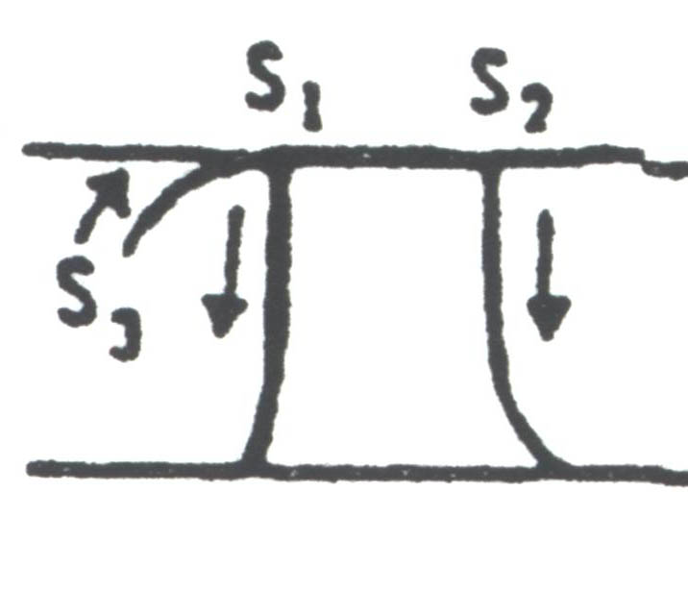
letter name sound English
Π π “pi” = “p” = P p
Notes:
Letter drawing from Nina Barclay. Eucleides' World: An Exploratory Introduction to Ancient Greek to Accompany Ecce Romani. CANE (Classical Association of New England), 2002.

Slide 8
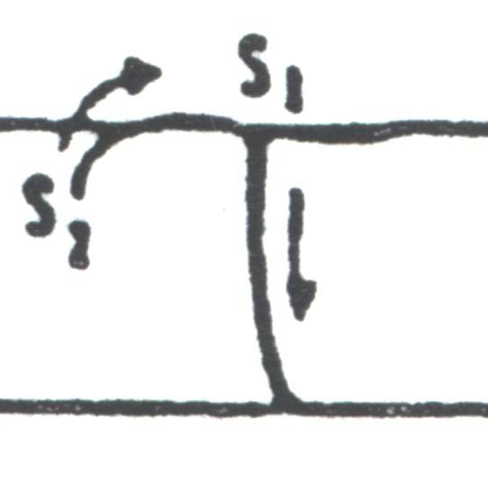
letter name sound English
Τ τ “tau” = “t” = T t
Notes:
Letter drawing from Nina Barclay. Eucleides' World: An Exploratory Introduction to Ancient Greek to Accompany Ecce Romani. CANE (Classical Association of New England), 2002.

Slide 9
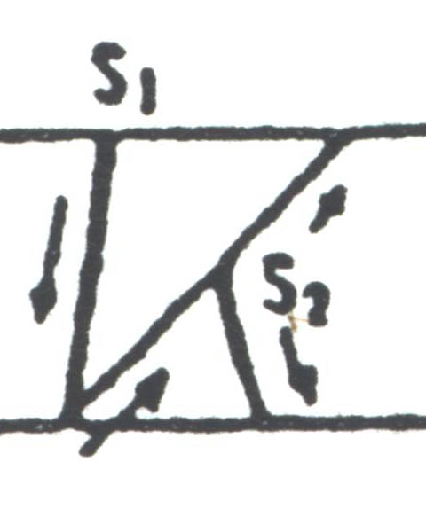
letter name sound English
Κ κ “kappa” = “k” = C c
K k
(Latin)
or
Notes:
Letter drawing from Nina Barclay. Eucleides' World: An Exploratory Introduction to Ancient Greek to Accompany Ecce Romani. CANE (Classical Association of New England), 2002.

Slide 10
Ancient Greek for Everyone
CONSONANTS Add a vocal sound and you get a new set, called “voiced”:
Labial Dental Palatal
π p τ t κ k = unvoiced
β b δ d γ g = voiced

Slide 11
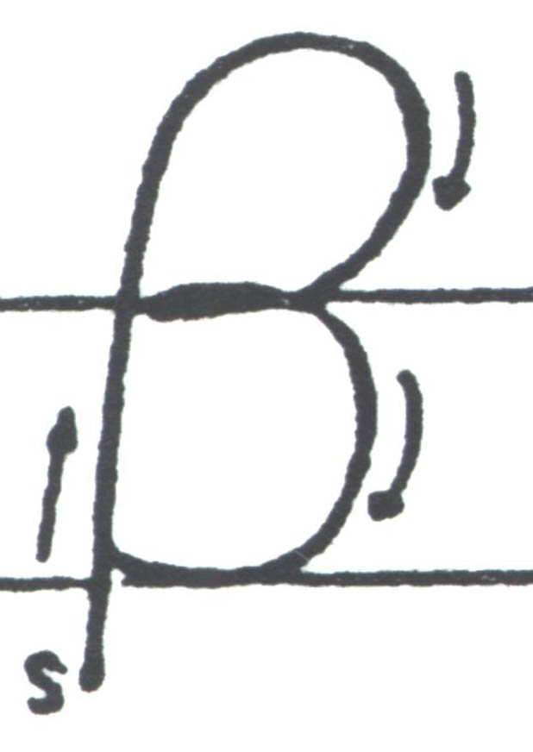
letter name sound English
Β β “beta” = “b” = B b
Notes:
Letter drawing from Nina Barclay. Eucleides' World: An Exploratory Introduction to Ancient Greek to Accompany Ecce Romani. CANE (Classical Association of New England), 2002.

Slide 12
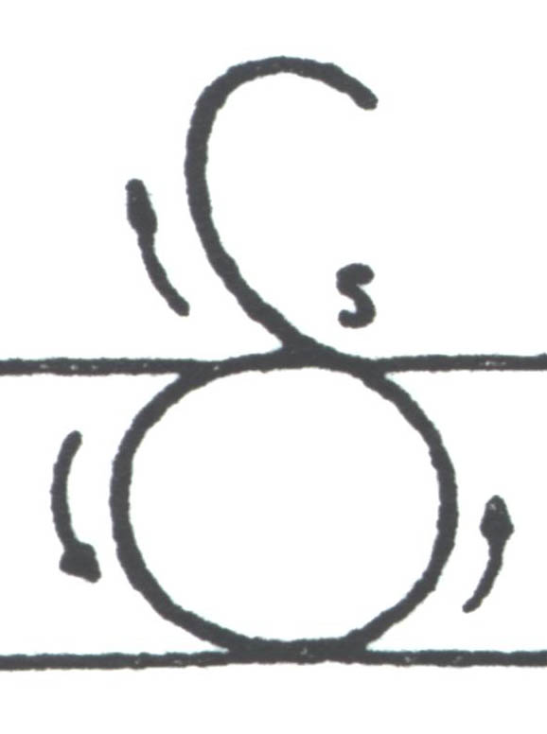
letter name sound English
Δ δ “delta” = “d” = D d
Notes:
Letter drawing from Nina Barclay. Eucleides' World: An Exploratory Introduction to Ancient Greek to Accompany Ecce Romani. CANE (Classical Association of New England), 2002.

Slide 13
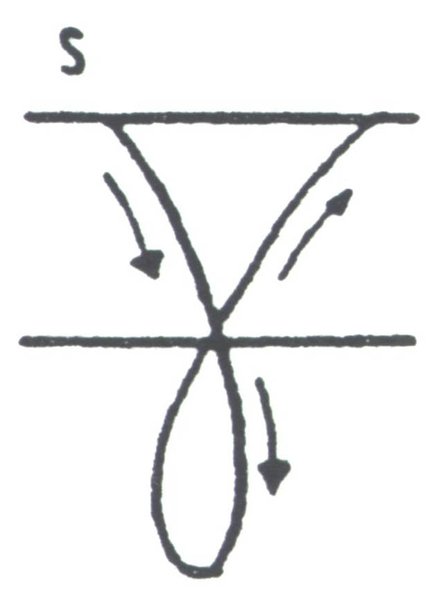
letter name sound English
Γ γ “gamma”= “g” = G g
Notes:
Letter drawing from Nina Barclay. Eucleides' World: An Exploratory Introduction to Ancient Greek to Accompany Ecce Romani. CANE (Classical Association of New England), 2002.

Slide 14
Ancient Greek for Everyone
CONSONANTS Add the “h” sound and
you get a new set, called “aspirated”:
Labial Dental Palatal
π p τ t κ k = unvoiced
β b δ d γ g = voiced
φ ph θ th χ kh = aspirated

Slide 15
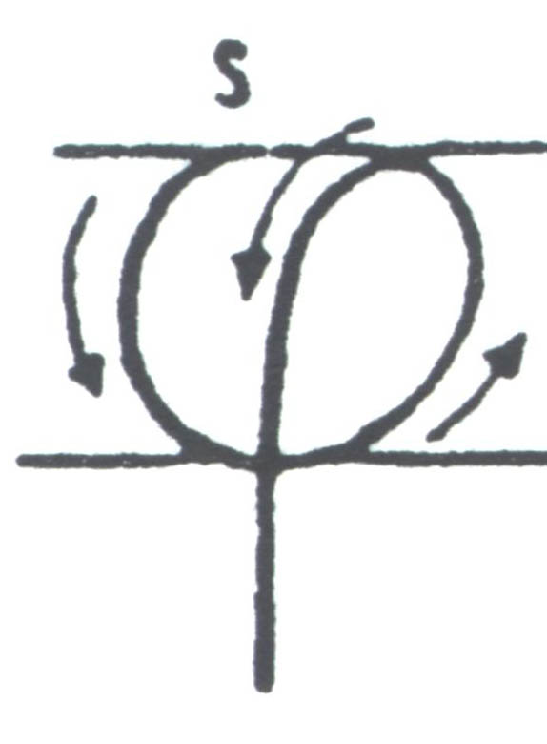
letter name sound English
Φ φ “phi” = “f” = Ph ph
Notes:
Letter drawing from Nina Barclay. Eucleides' World: An Exploratory Introduction to Ancient Greek to Accompany Ecce Romani. CANE (Classical Association of New England), 2002.

Slide 16
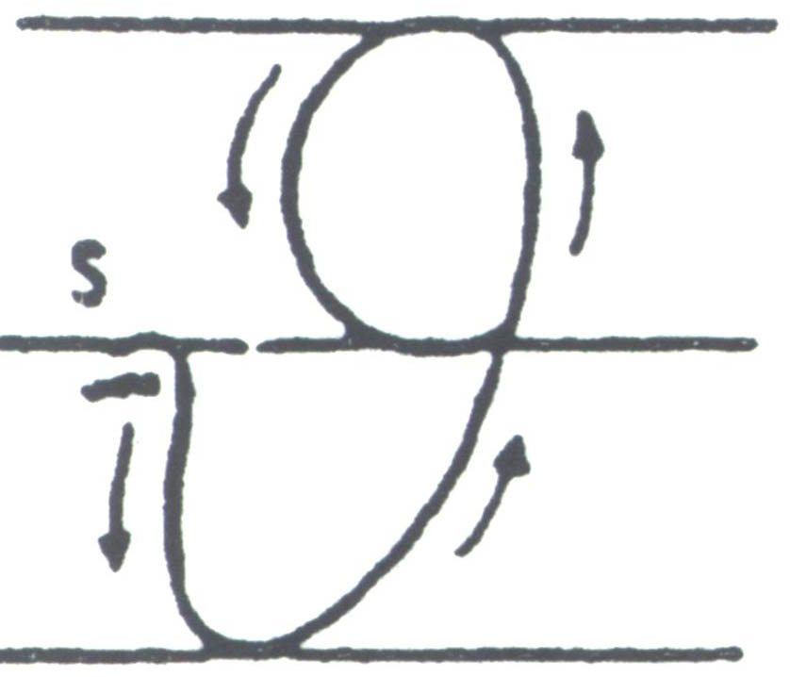
letter name sound English
Θ θ “theta” = “th” = Th th
Notes:
Letter drawing from Nina Barclay. Eucleides' World: An Exploratory Introduction to Ancient Greek to Accompany Ecce Romani. CANE (Classical Association of New England), 2002.

Slide 17
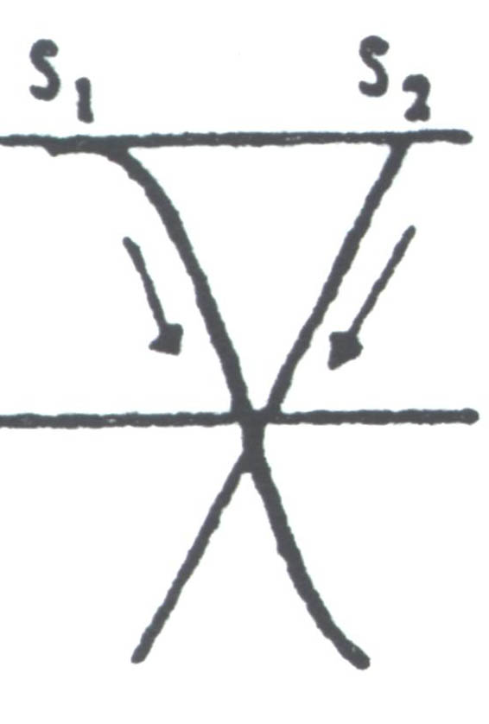
letter name sound English
Χ χ “chi” = “kh” = Ch ch
Kh kh
(Latin)
or
Notes:
Letter drawing from Nina Barclay. Eucleides' World: An Exploratory Introduction to Ancient Greek to Accompany Ecce Romani. CANE (Classical Association of New England), 2002.

Slide 18
Ancient Greek for Everyone
The Trouble with Sigma
Greek is strange when it comes to pronouncing and writing words with the “s” sound:
Culturally, ancient Greeks hated the “s” sound.
Poets were known to compose whole poems that never used the sound.
Nevertheless, the sound is very common in Greek.
Most often, if a word is odd or difficult to spell or pronounce, it is because of a sigma.
The weirdness appears even in the alphabet itself.

Slide 19
Ancient Greek for Everyone
The Trouble with Sigma
Greek is strange when it comes to pronouncing and writing words with the “s” sound:
The combinations πσ, βσ & φσ never appear.
Instead, ψ replaces them.
τ, δ and θ disappear before a σ.
The combinations κσ, γσ or χσ never appear.
Instead, ξ replaces them.

Slide 20
Ancient Greek for Everyone
CONSONANTS
Labial Dental Palatal
π p τ t κ k = unvoiced
β b δ d γ g = voiced
φ ph θ th χ kh = aspirated
ψ ps σ s ξ ks = + σ

Slide 21
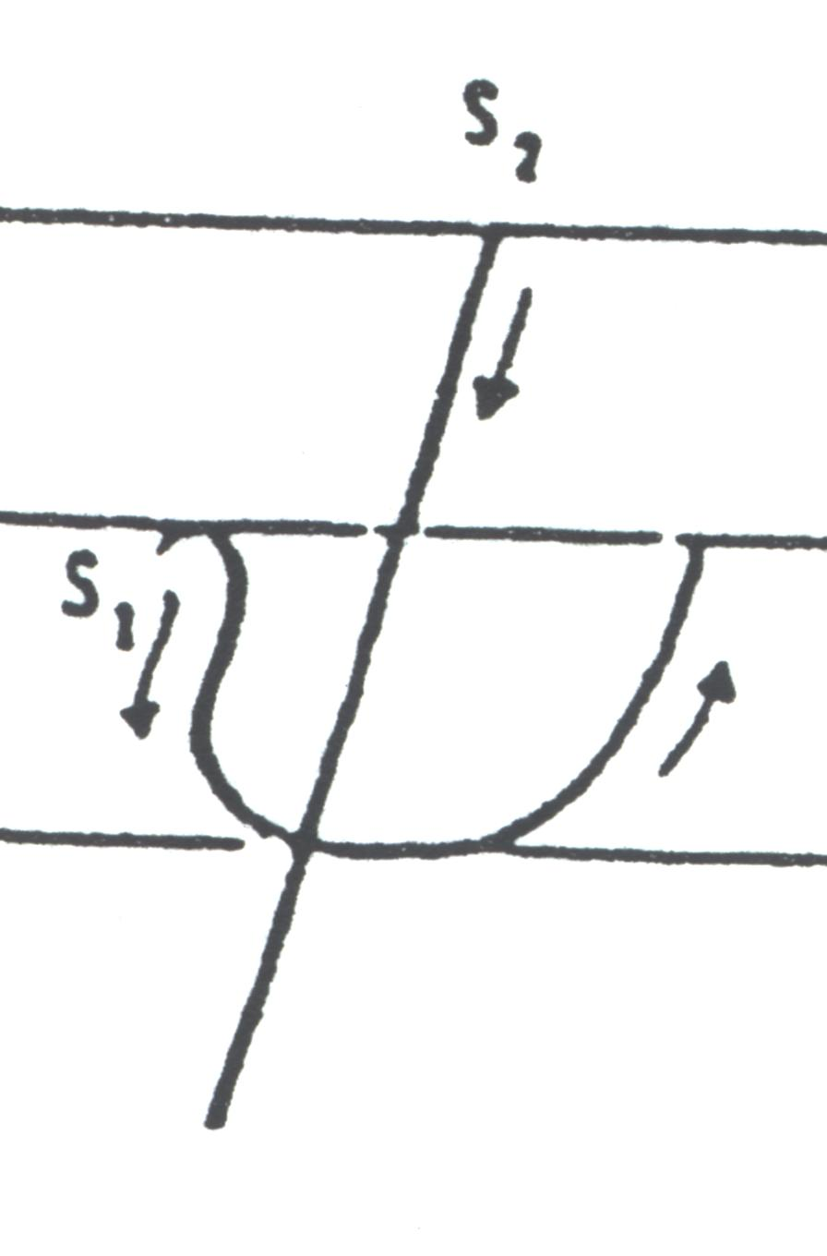
letter name sound English
Ψ ψ “psi” = “ps” = Ps ps
Notes:
Letter drawing from Nina Barclay. Eucleides' World: An Exploratory Introduction to Ancient Greek to Accompany Ecce Romani. CANE (Classical Association of New England), 2002.

Slide 22
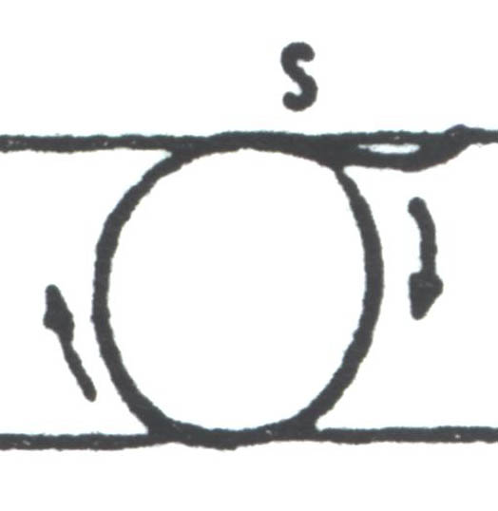
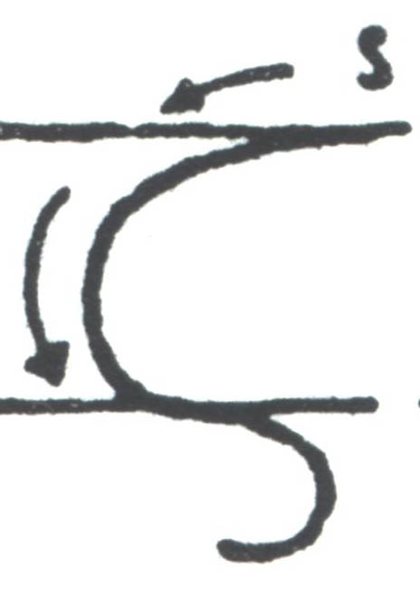
letter name sound English
Σ σ ς “sigma” = “s” = S s
use ς only at the end of words
(σ is a cursive formed designed to continue into the next letter;
at the end of the word, this link is unnecessary)
Notes:
Letter drawing from Nina Barclay. Eucleides' World: An Exploratory Introduction to Ancient Greek to Accompany Ecce Romani. CANE (Classical Association of New England), 2002.

Slide 23
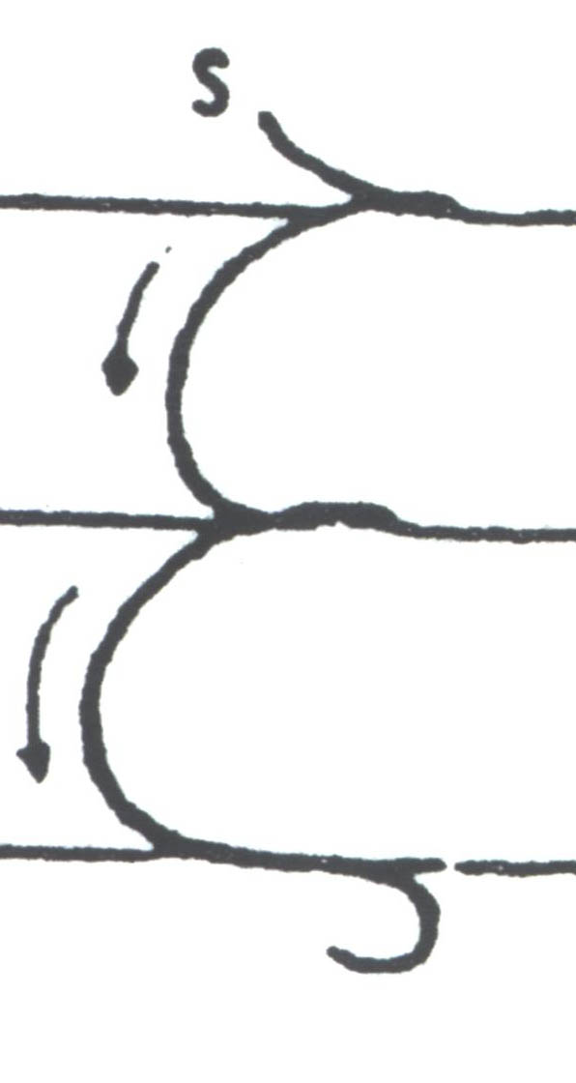
letter name sound English
Ξ ξ “xi” = “ks” = X x
Notes:
Letter drawing from Nina Barclay. Eucleides' World: An Exploratory Introduction to Ancient Greek to Accompany Ecce Romani. CANE (Classical Association of New England), 2002.

Slide 24
Ancient Greek for Everyone
CONSONANTS
Labial Dental Palatal
π p τ t κ k = unvoiced
β b δ d γ g = voiced
φ ph θ th χ kh = aspirated
ψ ps σ s ξ ks = + σ
μ m ν n γκ, γγ, γχ, γξ ng
= nasals

Slide 25
Ancient Greek for Everyone
Gamma as a nasal sound
Normally, the letter γ is pronounced like a hard “g” in English.
Before another palatal sound (κ, γ, χ, ξ), however, saying a hard “g” sound is too difficult, so it softens to an “ng” sound.
English words do this, too:
γκ = ngk, like “ankle”
γγ = ng, like “angle”
γχ = ngkh, like “ankh”
γξ = ngks, like “angst” but more like “angkst”

Slide 26
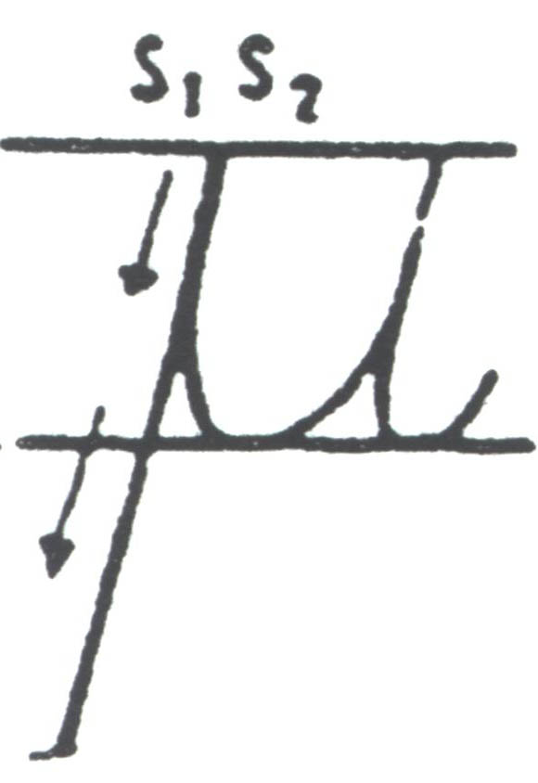
letter name sound English
Μ μ “mu” = “m” = M m
Notes:
Letter drawing from Nina Barclay. Eucleides' World: An Exploratory Introduction to Ancient Greek to Accompany Ecce Romani. CANE (Classical Association of New England), 2002.

Slide 27
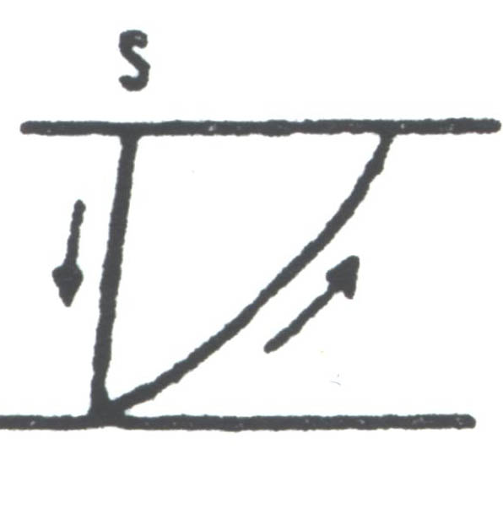
letter name sound English
Ν ν “nu” = “n” = N n
Notes:
Letter drawing from Nina Barclay. Eucleides' World: An Exploratory Introduction to Ancient Greek to Accompany Ecce Romani. CANE (Classical Association of New England), 2002.

Slide 28
Ancient Greek for Everyone
CONSONANTS
Labial Dental Palatal
π p τ t κ k = unvoiced
β b δ d γ g = voiced
φ ph θ th χ kh = aspirated
ψ ps σ s ξ ks = + σ
μ m ν n γκ, γγ, γχ, γξ ng nasals
λ l ρ r = liquids

Slide 29
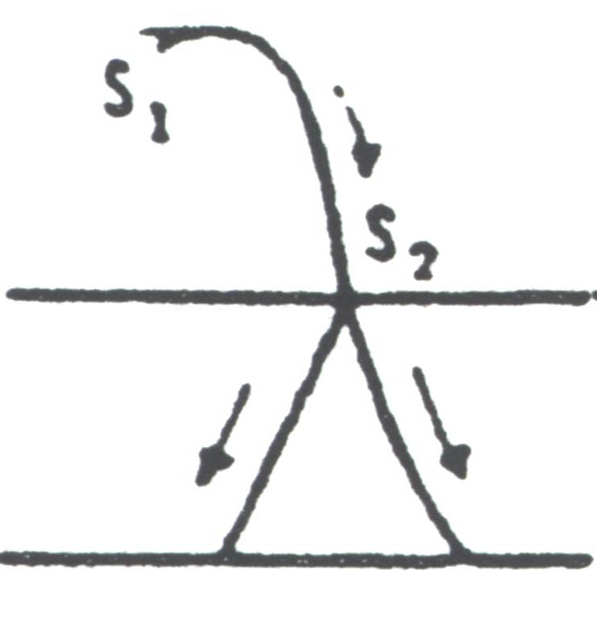
letter name sound English
Λ λ “lambda” = “l” = L l
Notes:
Letter drawing from Nina Barclay. Eucleides' World: An Exploratory Introduction to Ancient Greek to Accompany Ecce Romani. CANE (Classical Association of New England), 2002.

Slide 30
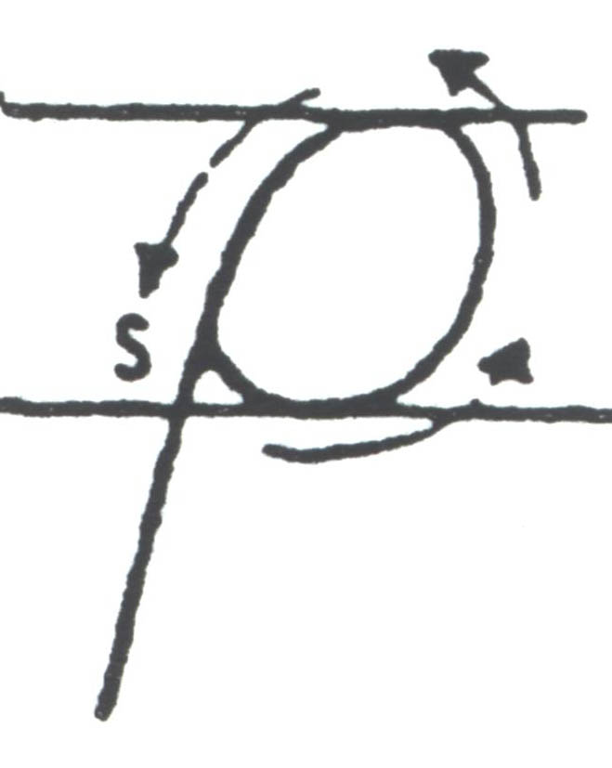
letter name sound English
Ρ ρ “rho” = “r” = R r
Notes:
Letter drawing from Nina Barclay. Eucleides' World: An Exploratory Introduction to Ancient Greek to Accompany Ecce Romani. CANE (Classical Association of New England), 2002.

Slide 31
Ancient Greek for Everyone
The leftover consonant is:
ζ (instead of writing σδ)

Slide 32
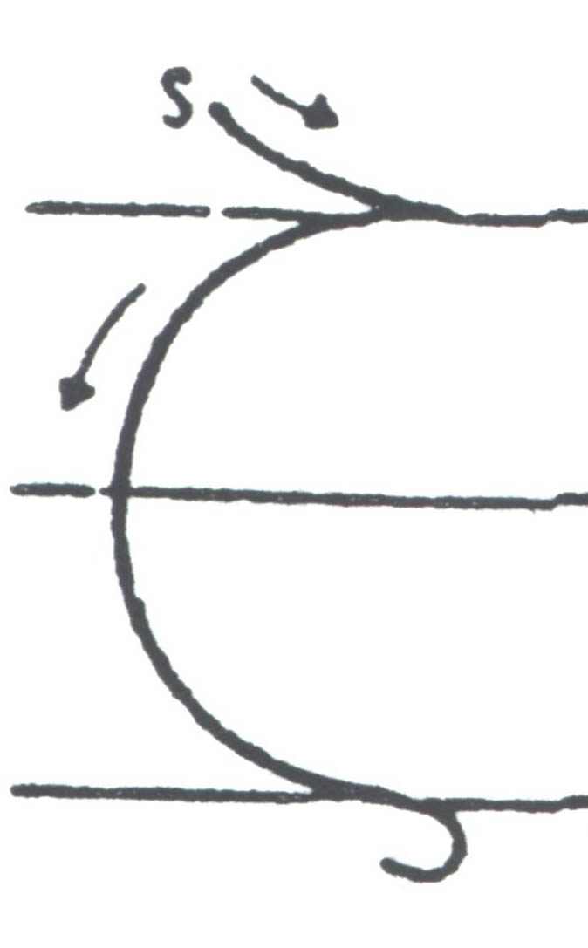
letter name sound English
Ζ ζ “zeta” = “z” = Z z
Notes:
Letter drawing from Nina Barclay. Eucleides' World: An Exploratory Introduction to Ancient Greek to Accompany Ecce Romani. CANE (Classical Association of New England), 2002.

Slide 33
Ancient Greek for Everyone
Next
Everything else you need to know to write and pronounce Greek:
accent marks
breathing marks
punctuation
How to type in ancient Greek
The alphabet in alphabetical order

